Slide 1
CTE-101:
Understanding the Basics

Slide 2
C-TEC:
Career & Technology Education Centers of Licking County

Slide 3
Overview
10 Associate Schools
15 Satellite Programs (2015)
  8 Middle School
  7 High School
County Connections: Superintendents, Principals, Counselors, County Involvement

Slide 4
C-TEC Vision
Vision
The Career and Technology Education Centers will be the area's premier workforce provider by developing skilled workers and community-minded citizens who engage in continuous learning.
Middle Grades/High School Satellite
The Career and Technology Education Centers will provide support to all associate districts to engage students in grades 7-12 in career exploration.

Slide 5
History of Satellite Planning

Slide 6
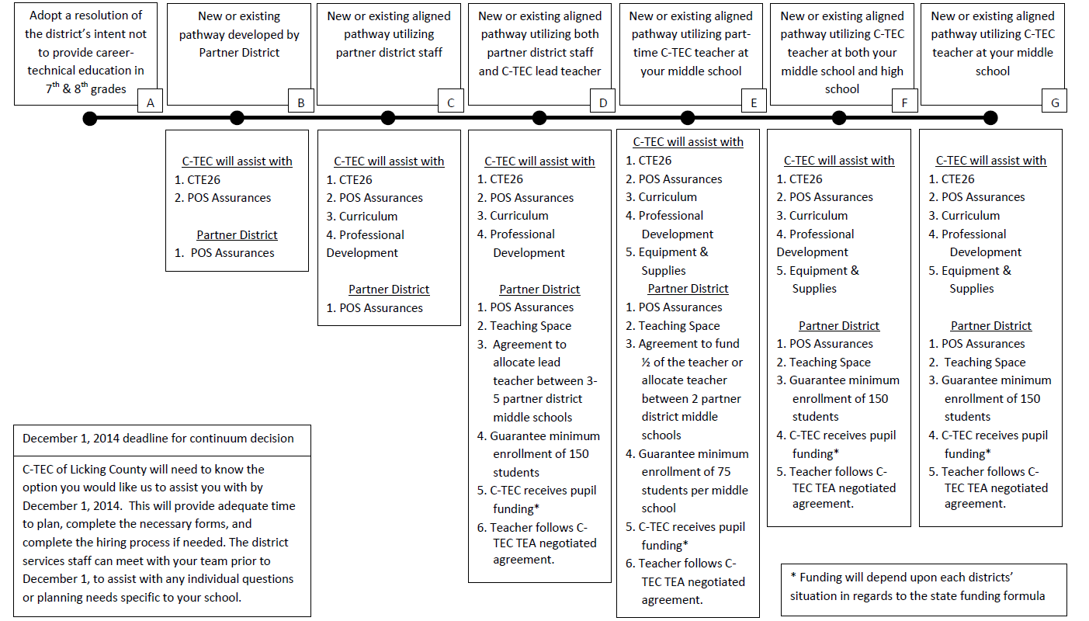
Middle School Collaboration Continuum

Slide 7
Building a Pathway
Middle School to High School
Owned/Unowned/Combination

Slide 8
Planning:
Business and Industry: Licking Heights (IT, Medical)
Heath: Medical and Engineering
Manufacturing
Partnerships and Experiences
  Guest Speakers
  Tours
  Advisory
  Work Based learning experiences

Slide 9
C-TEC’s Support to the Districts
What is the value of the CTPD Lead to member associate schools?
What type of relationship do you want to build with associate schools?
What resources can the CTPD Lead provide in developing the vision?
Communicate the vision with all stakeholders!

Slide 10
Relationships/Support
C-TEC will lead the CTE expansion in Licking County.
CTE expansion must benefit all districts in our CTPD.
C-TEC will provide support to all satellite and associate owned CTE programs.
C-TEC will provide training for administrators, counselors, EMIS coordinators, and curriculum staff.
CTE expansion is truly a partnership of districts!

Slide 11
The C-TEC Value!
CTE Expertise
Industry Input
Partnership Development
CTE Staffing Experience
Program of Study Development
Professional Development
Curriculum Alignment and Development
Industry Credentials and accreditations
Quality Program Assurances/Reviews

Slide 12
Business & Industry
Working with our local Chamber and Work force development groups
2 Year Colleges
Bringing Business into the school

Slide 13


Thank you!
For more information:
On the web visit www.c-tec.edu
Check us out on :
ctec/education
@cteclickingco
QUESTIONS?

Slide 14
C-TEC: 150 Price Rd
Newark, OH 43055
Dr. Joyce Malainy
Superintendent
jmalainy@c-tec.edu
Stephanie Priestnal
Director of District Services
spriestnal@c-tec.edu

